Slide 1
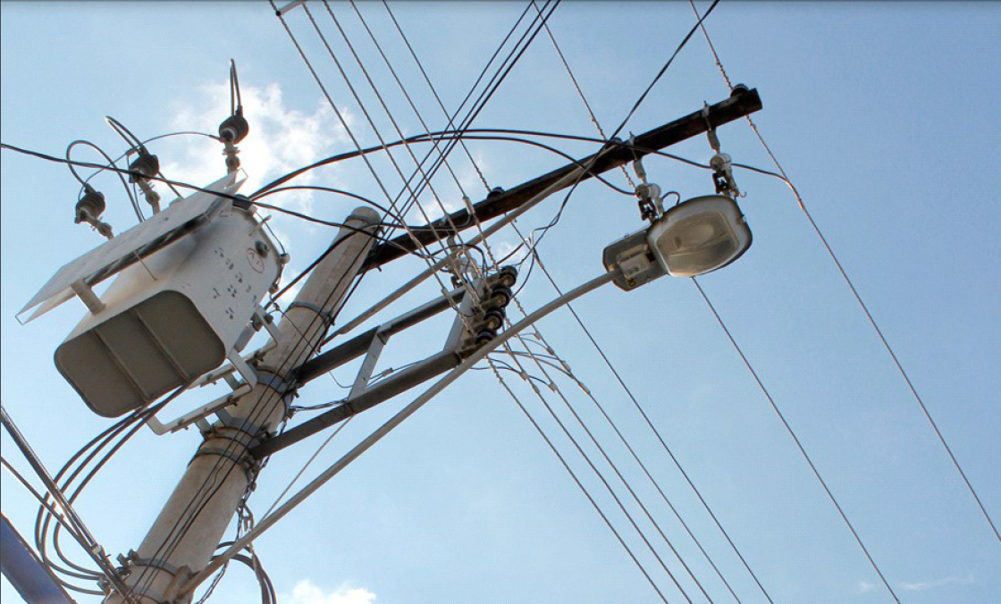
TRANSFORMERS

Slide 2
WHY TRANSFORMERS ?
A transformer is a highly efficient device for changing ac voltage from one value to another, for example 240V to 6V.
The transformer is one of the most useful electrical devices.
It can:
􀂃 Raise or lower the voltage or current in an ac circuit,
􀂃 Isolate circuits from one another, and
􀂃 Change the impedance of the load as seen by the source, thus enable load matching which results in maximum power transfer.
Transformers come in all sizes, from the enormous transformers used in power stations to the small transformers used for doorbells.

Slide 3
WHY TRANSFORMERS ?
Without transformers, electricity as we know it today would be almost unusable.
For every aspect of electricity generation, transmission and distribution, there is a range of optimum voltage that the transformer enables us to use. In general, the higher the voltage, the more insulation and switching costs, but less current used, so lower I²R loss and greater efficiency results.
It enables us to transmit electrical energy over great distances and to distribute it to the end-users in factories and homes.

Slide 4
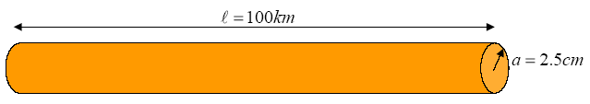
Power Transmission
Typical power requirement for a small city: 1000MWMaximum voltage provided by typical generator: 30 KV Thus need a current of 3.3*10⁴A
Suppose generator is 50 km from city. Copper transmission line 2.5 cm in radius.
Note that the total wire length is 100 km, and the weigh of such a wire is 1,749,474 kg.

Slide 5



Power Transmission
Resistance over length of transmission line length: 0.86Ω.
Power loss in wire conduit: 950MW
Leaves about 50MW for city.
Need very large core to handle this current without saturation.

Slide 6

Power Transmission
Solution is to step up the voltage and thus reduce the current and power loss in copper conduit.
  Typical AC high voltage line: 765 kV
  Current required: I = 1000 A
  Power loss in wire conduit: 0.86MW
  Leaves about 999.14MW for city.

Slide 7
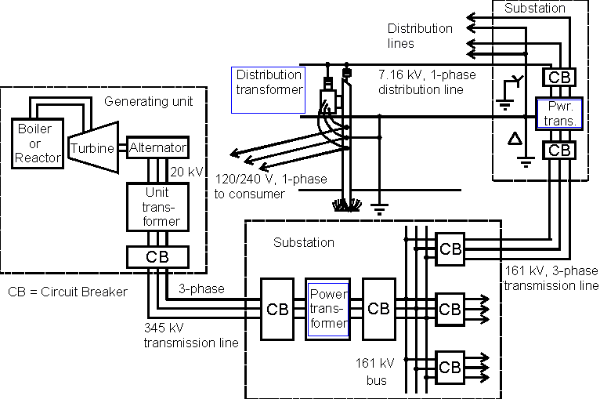
Power System Network

Slide 8
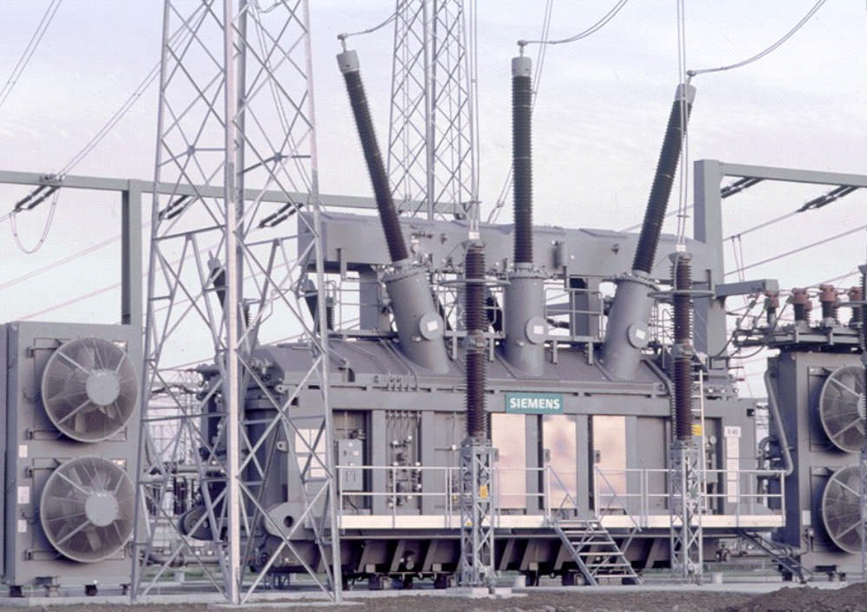
Three-Phase
Power Transformer

Slide 9
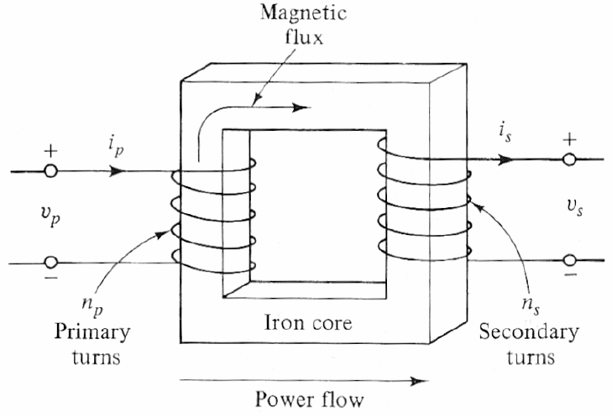
SELF INDUCTANCE
A transformer is a device in which the current in one circuit induces an EMF in a second circuit through the changing magnetic field.
To understand how current in one circuit induced EMF in another, we will first examine how a current in a circuit can induce an EMF in the same circuit.

Slide 10
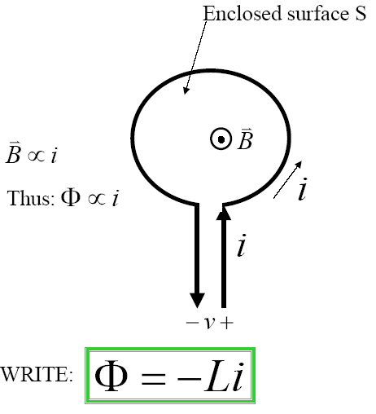
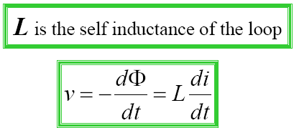
SELF INDUCTANCE
Consider a single wire loop Current in loop produces a magnetic field B, giving a flux through the loop.

Slide 11
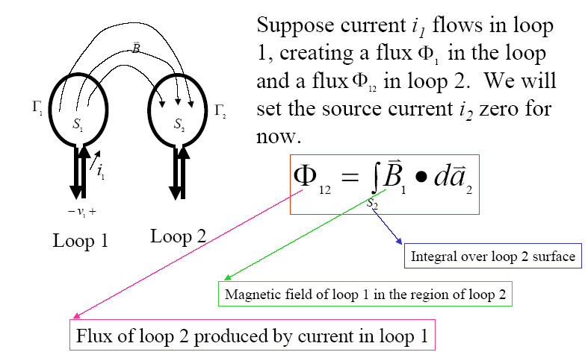
MUTUAL INDUCTANCE

Slide 12
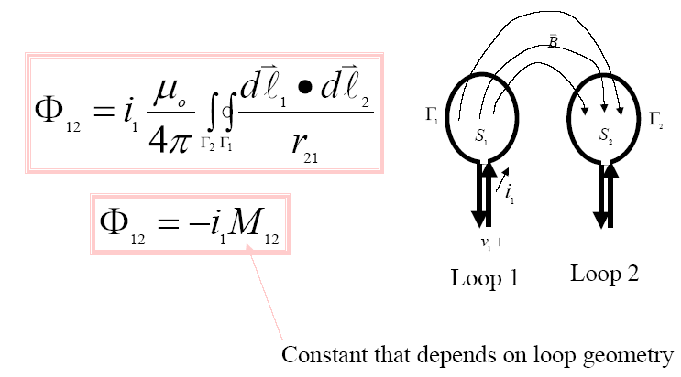
MUTUAL INDUCTANCE

Slide 13
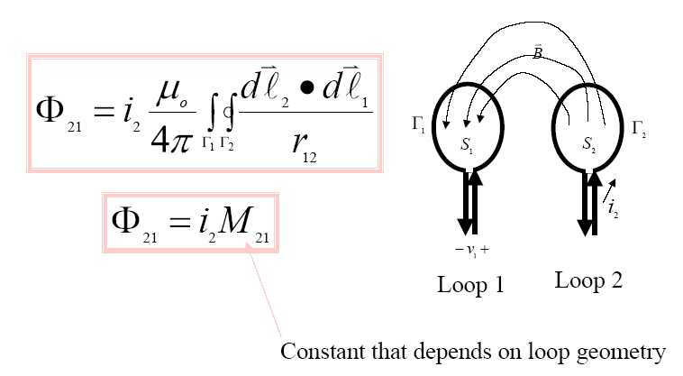
MUTUAL INDUCTANCE

Slide 14
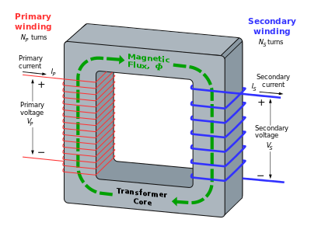
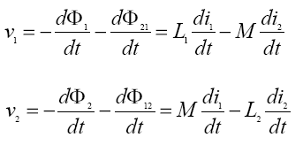
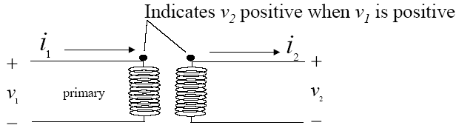
MUTUAL INDUCTANCE

Slide 15
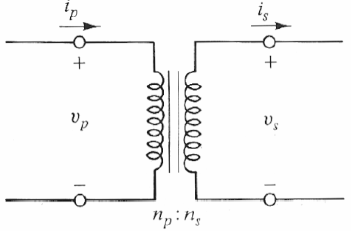
THE IDEAL TRANSFORMER
The core permeability is infinite; the reluctance of the core is zero.
No magnetic flux leaks out between the two windings (that is, all the flux links all the turns)
The winding resistance is zero
There is no hysteresis or eddy-current power loss in the core

